Slide 1
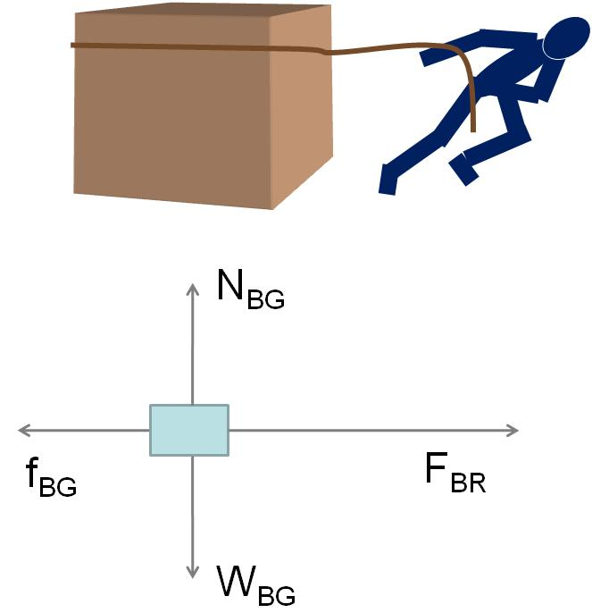

Slide 2
High Potential
Low Potential
E
+ + + + + + + + + + + + + + + + + + + + + + + + + +
+ + + + + + + + + + + + + + + + + + + + + + + + + +
+
A
B
- - - - - - - - - - - - - - - - - - - - - - - - - - - - - -
- - - - - - - - - - - - - - - - - - - - - - - - - - - - - -
d

Slide 3
High Potential
Low Potential
E
Conductor
+ + + + + + + + + + + + + + + + + + + + + + + + + +
+ + + + + + + + + + + + + + + + + + + + + + + + + +
+
A
B
- - - - - - - - - - - - - - - - - - - - - - - - - - - - - -
- - - - - - - - - - - - - - - - - - - - - - - - - - - - - -
d

Slide 4
High Potential
Low Potential
Parabolic electron Path Segments
E
- - - - - - - - - - - - - - - - - - - - - - - - - - - - - -
- - - - - - - - - - - - - - - - - - - - - - - - - - - - - -
+ + + + + + + + + + + + + + + + + + + + + + + + + +
+ + + + + + + + + + + + + + + + + + + + + + + + + +
Conductor

Slide 5
High Potential
Low Potential
E
Conductor
+
- - - - - - - - - - - - - - - - - - - - - - - - - - - - - -
- - - - - - - - - - - - - - - - - - - - - - - - - - - - - -
+ + + + + + + + + + + + + + + + + + + + + + + + + +
+ + + + + + + + + + + + + + + + + + + + + + + + + +
d

Slide 6
-
-
-
-
-
-
-
-
-
E
- - - - - - - - - - - - -
+ + + + + + + + + + +
+
+
+
+
-
-
-
-
+
+
-
-
-
+
+
+
+
-
-
-
-
+
+
-
-
+
+
+
+
-
-
-
-
1
2
3
4

Slide 7
x
+
+
+
+
+
+
E
θ
+
+
z
+
R
+
P
+
+
y
+
+

Slide 8
-
-
-
-
-
-
-
-
-
E
- - - - - - - - - - - - -
+ + + + + + + + + + +
+
+
+
+
-
-
-
-
+
+
-
-
E₁
-
+
+
+
+
-
-
-
-
+
+
-
-
+
+
+
+
-
-
-
-
1
2
3
4

Slide 9
-
-
-
-
-
-
-
-
-
E
- - - - - - - - - - - - -
+ + + + + + + + + + +
+
+
+
+
-
-
-
-
+
+
E₂
E₃
-
-
E₁
-
+
+
+
+
-
-
-
-
+
+
E₄
-
-
E₂
E₃
+
+
+
+
-
-
-
-
1
2
3
4

Slide 10
-
-
-
-
-
-
-
-
-
E
- - - - - - - - - - - - -
+ + + + + + + + + + +
+
+
+
+
-
-
-
-
+
+
E_{net}
E_{net}
E_{net}
-
-
-
+
+
+
+
-
-
-
-
+
+
-
-
+
+
+
+
-
-
-
-
1
2
3
4

Slide 11
Case 1: Negative charges flow to the right
Result: Left side is more positive than before, Right side is more negative than before
Case 2: Negative charges flow to the right
+
+
+
+
Result: Left side is more positive than before, Right side is more negative than before

Slide 12
Current Flow Direction
Electron Flow Direction

Slide 15
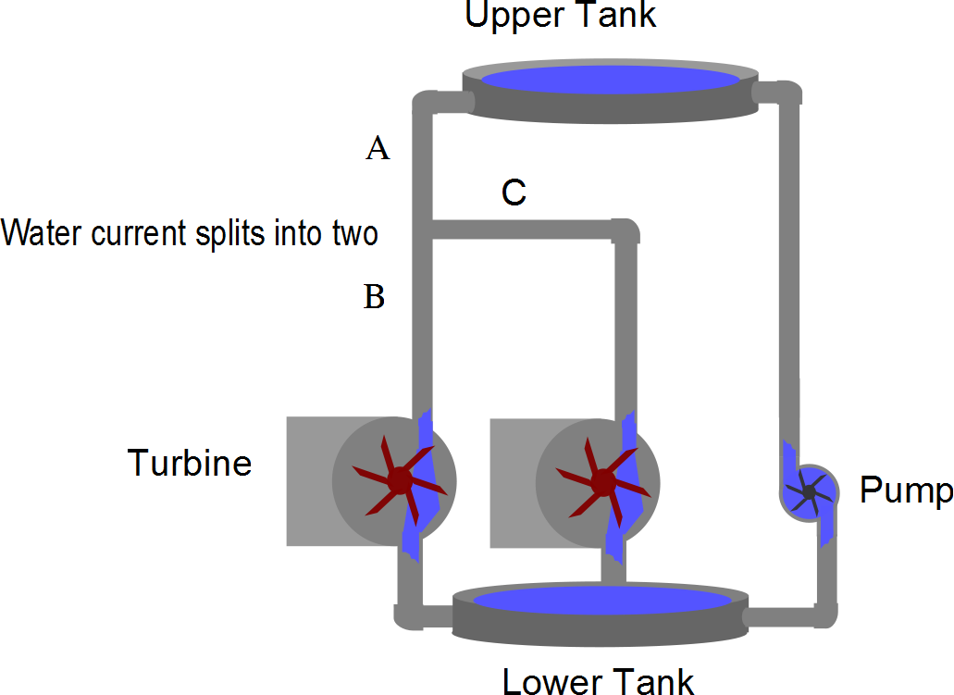
Water current splits into two

Slide 16
